Slide 1
ECE 105: Introduction to Electrical Engineering
Lecture 5
Device 1
Yasser Khan
Rehan Kapadia

Slide 2
How can we create tunable resistors?
R = ρL/A
We have three options, change length, change area, or change resistivity
Semiconductors allow us to electromagnetically and chemically control resistivity

Slide 3
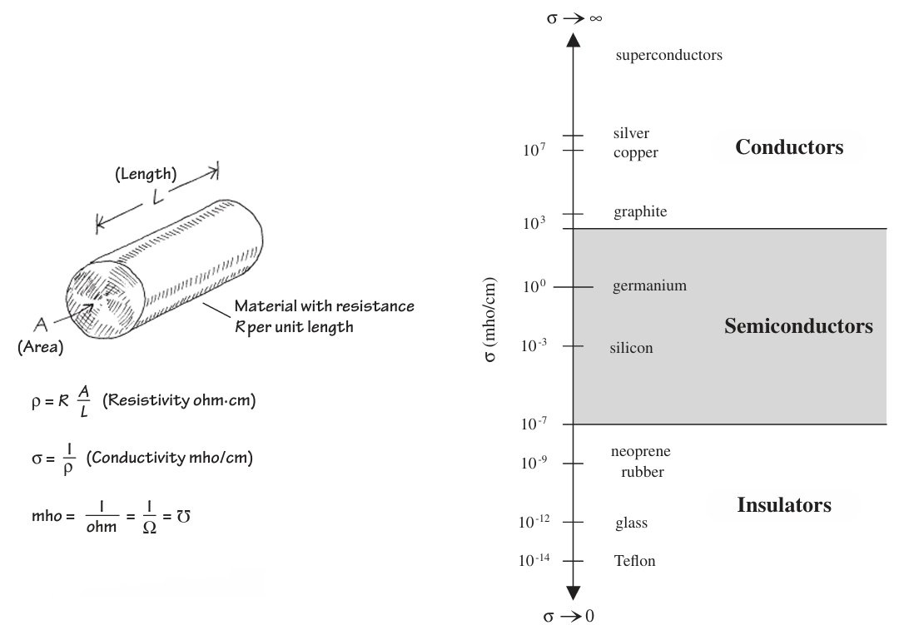
How do semiconductors allow us to tune the resistivity?
By allowing us to tune the density of charge carriers!
In metals, the density of charge carriers is ~ 10²² -10²³/cm³
In insulators, the charge density is ~10⁻⁵⁷/cm³
In semiconductors, the charge density can be controlled from ~10¹⁰/cm³ – 10²⁰/cm³

Slide 4
What can we do with an element that has tunable or non-linear resistance?
Create a switch
Digital logic
Amplify a signal
Analog circuits
Rectify an AC voltage
Power circuits
Sensing, power generation, light, etc etc

Slide 5
Why does changing the carrier density change the resistivity?
Let’s revisit R = ρL/A
If I take a material and magically stuff additional mobile electrons into it, then the resistivity would decrease.
If I remove additional mobile electrons from it, then the resistivity would increase.
So if I had a material which allows me to change the mobile charge density, then I can tune the resistivity of that material

Slide 6
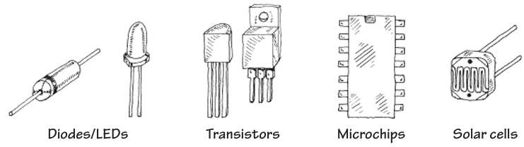
What’s after resistors, capacitors, and inductors
Each device and circuit allows us to carry out specific functionalities

Slide 7
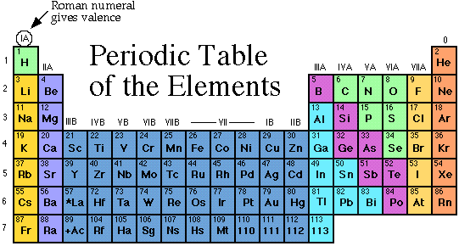
What are semiconductors
Elements: Si, Ge, C
Binary: GaAs, InSb, SiC, CdSe, etc.
Ternary+: AlGaAs, InGaAs, etc.

Slide 8
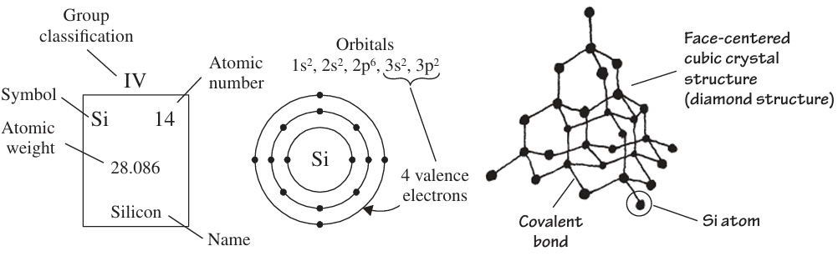
Silicon – the workhorse of electronics

Slide 9
Silicon Crystal Structure
Electrons and Holes in Semiconductors
Unit cell of silicon crystal is cubic.
Each Si atom has 4 nearest neighbors.
Å

Slide 10
Bond Model of Electrons and Holes (Intrinsic Si)
•
Silicon crystal in
a two-dimensional
representation.
Si
Si
Si
Si
Si
Si
Si
Si
Si
Si
Si
Si
Si
Si
Si
Si
Si
Si
•
When an electron breaks loose and becomes a
conduction
electron
, a
hole
is also created.

Slide 11
Dopants in Silicon
Si
Si
Si
Si
Si
Si
Si
As
Si
Si
B
Si
Si
Si
Si
Si
Si
Si
N-type Si
P-type Si
•
As (Arsenic), a Group V element, introduces conduction electrons and creates
N-type silicon,
and is called a donor.
•
B (Boron), a Group III element, introduces holes and creates P-type silicon,
and is called an acceptor.
•
Donors and acceptors are known as dopants.

Slide 12
GaAs, III-V Compound Semiconductors, and Their Dopants
Ga
As
Ga
As
Ga
As
Ga
As
Ga
•
GaAs has the same crystal structure as Si.
•
GaAs, GaP, GaN are III-V compound semiconductors, important for
optoelectronics.
•
Which group of elements are candidates for donors? acceptors?

Slide 13
Energy Band Diagram
Conduction band
E
c
E
Band gap
g
E
v
Valence band
•
Energy band diagram shows the bottom edge of conduction band, E_{c} , and top edge of valence band, E_{v} .
•
E_{c} and E_{v} are separated by the band gap energy, E_{g} .

Slide 14
Measuring the Band Gap Energy by Light Absorption
electron
E
c
photons
E
g
photon energy: h
v
> E
g
E
v
hole
E_{g} can be determined from the minimum energy (hν) of photons that are absorbed by the semiconductor.
Bandgap energies of selected semiconductors
Material
PbTe
Ge
Si
GaAs
GaP
Diamond
E
g
(eV)
0.31
0.67
1.12
1.42
2.25
6.0

Slide 15
Semiconductors, Insulators, and Conductors
E
c
Top of
conduction band
E
g
=
9 eV
E
empty
=
c
E
g
1.1 eV
filled
E
v
E
v
E
c
Si (Semiconductor)
SiO
(Insulator)
Conductor
2
•
Totally filled bands and totally empty bands do not allow
current flow. (Just as there is no motion of liquid in a totally filled or totally empty bottle.)
.
•
Metal conduction band is half-filled.
•
Semiconductors have lower E
's than insulators and can be
g
doped.

Slide 16
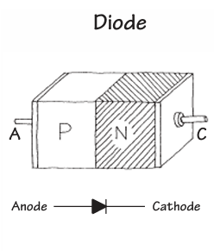
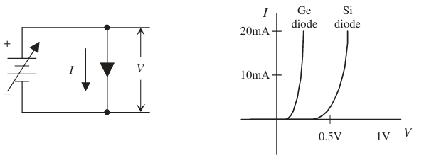
What is a diode
A diode is a device that exhibits ‘rectifying’ behavior
Can be made from a physical junction between an n-type semiconductor and a p-type semiconductor
Can also be made from a physical junction between a metal and semiconductor (not discussed here)

Slide 17
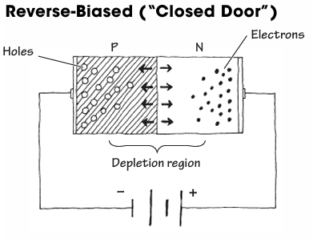
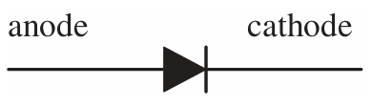
Reverse biasing a diode

Slide 18
Diode characterization

Slide 19
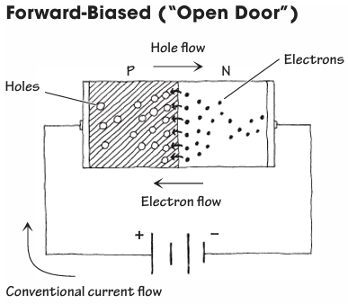
Forward biasing a diode

Slide 20
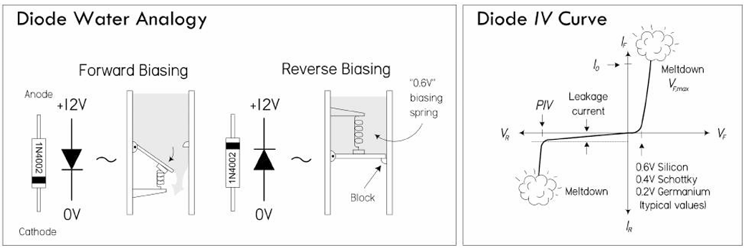
Water analogy

Slide 21
How do we figure out the behavior?
Define the physical system
Write the differential equations
Solve the differential equations
Simplify the results for relevant conditions
Materials Science, Chemistry, Physics, etc
Physics, Chemistry
Math, Computing
Engineering

Slide 22
Solving for diode current equations

Slide 23
Solving for diode current equations

Slide 24
Solving for diode current equations

Slide 25
Solving for diode current equations

Slide 26
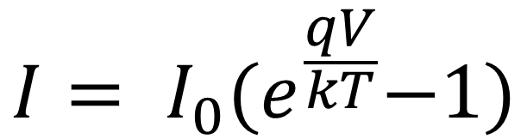
Ideal Diode Current Equation
$$I= I_{0}{(e}^{\frac{qV}{kT}}−1)$$
This equation describes the behavior of an ideal diode

Slide 27
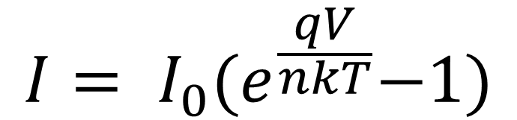
Non-Ideal Diode Current Equation
$$I= I_{0}{(e}^{\frac{qV}{nkT}}−1)$$
This equation partially describes the behavior of a non-ideal diode

